Slide 1

Online Examination System (ExamZone)
Secure, Scalable & Automated Assessment Platform
Presented by:
Ayesha Usman (BSSE23031) , Laiba Alam (BSSE23061) , Rozalia Sheraz (BSSE23093)
Technologies: HTML, CSS, JavaScript, Node.js, AWS (Lambda, DynamoDB, API Gateway)

Slide 2

Executive Summary: ExamZone
ExamZone automates quizzes and exams for educational institutions, ensuring fair, fast, and reliable assessment.
1
Secure Roles
Student and teacher access.
2
Timer-Based
Exams and quizzes.
3
Auto Results
Automatic generation.
4
Cloud Backend
Powered by AWS.

Slide 3

Challenges of Traditional Systems
Time-Consuming & Error-Prone
Manual checking leads to delays and mistakes.
Lack of Monitoring
No real-time exam oversight.
Management Difficulty
Struggles with large student numbers.
Poor Security
Vulnerable data handling.

Slide 4

ExamZone: Our Solution
Automated & Secure
Automates exam creation, attempt, and evaluation.
Keyword-based auto-checking for subjective exams.
Secure cloud storage for results.
Role-based access for students and teachers.

Slide 5








System Architecture Overview
Frontend
Backend
HTML, CSS, JS for Student & Teacher Dashboards, Timer-based exams.
Node.js with AWS Lambda, REST APIs via API Gateway.
Security
Database
IAM-based authentication, Role-based access control.
AWS DynamoDB stores users, exams, quizzes, and results.

Slide 6







Methodology & Workflow
Teacher Creates
Quizzes/exams.
Data Stored
In DynamoDB.
Student Logs In
Views available exams.
Timer Starts
When exam begins.
Student Submits
Answers.
System Evaluates
Automatically.
Results Displayed
Stored and shown.

Slide 7
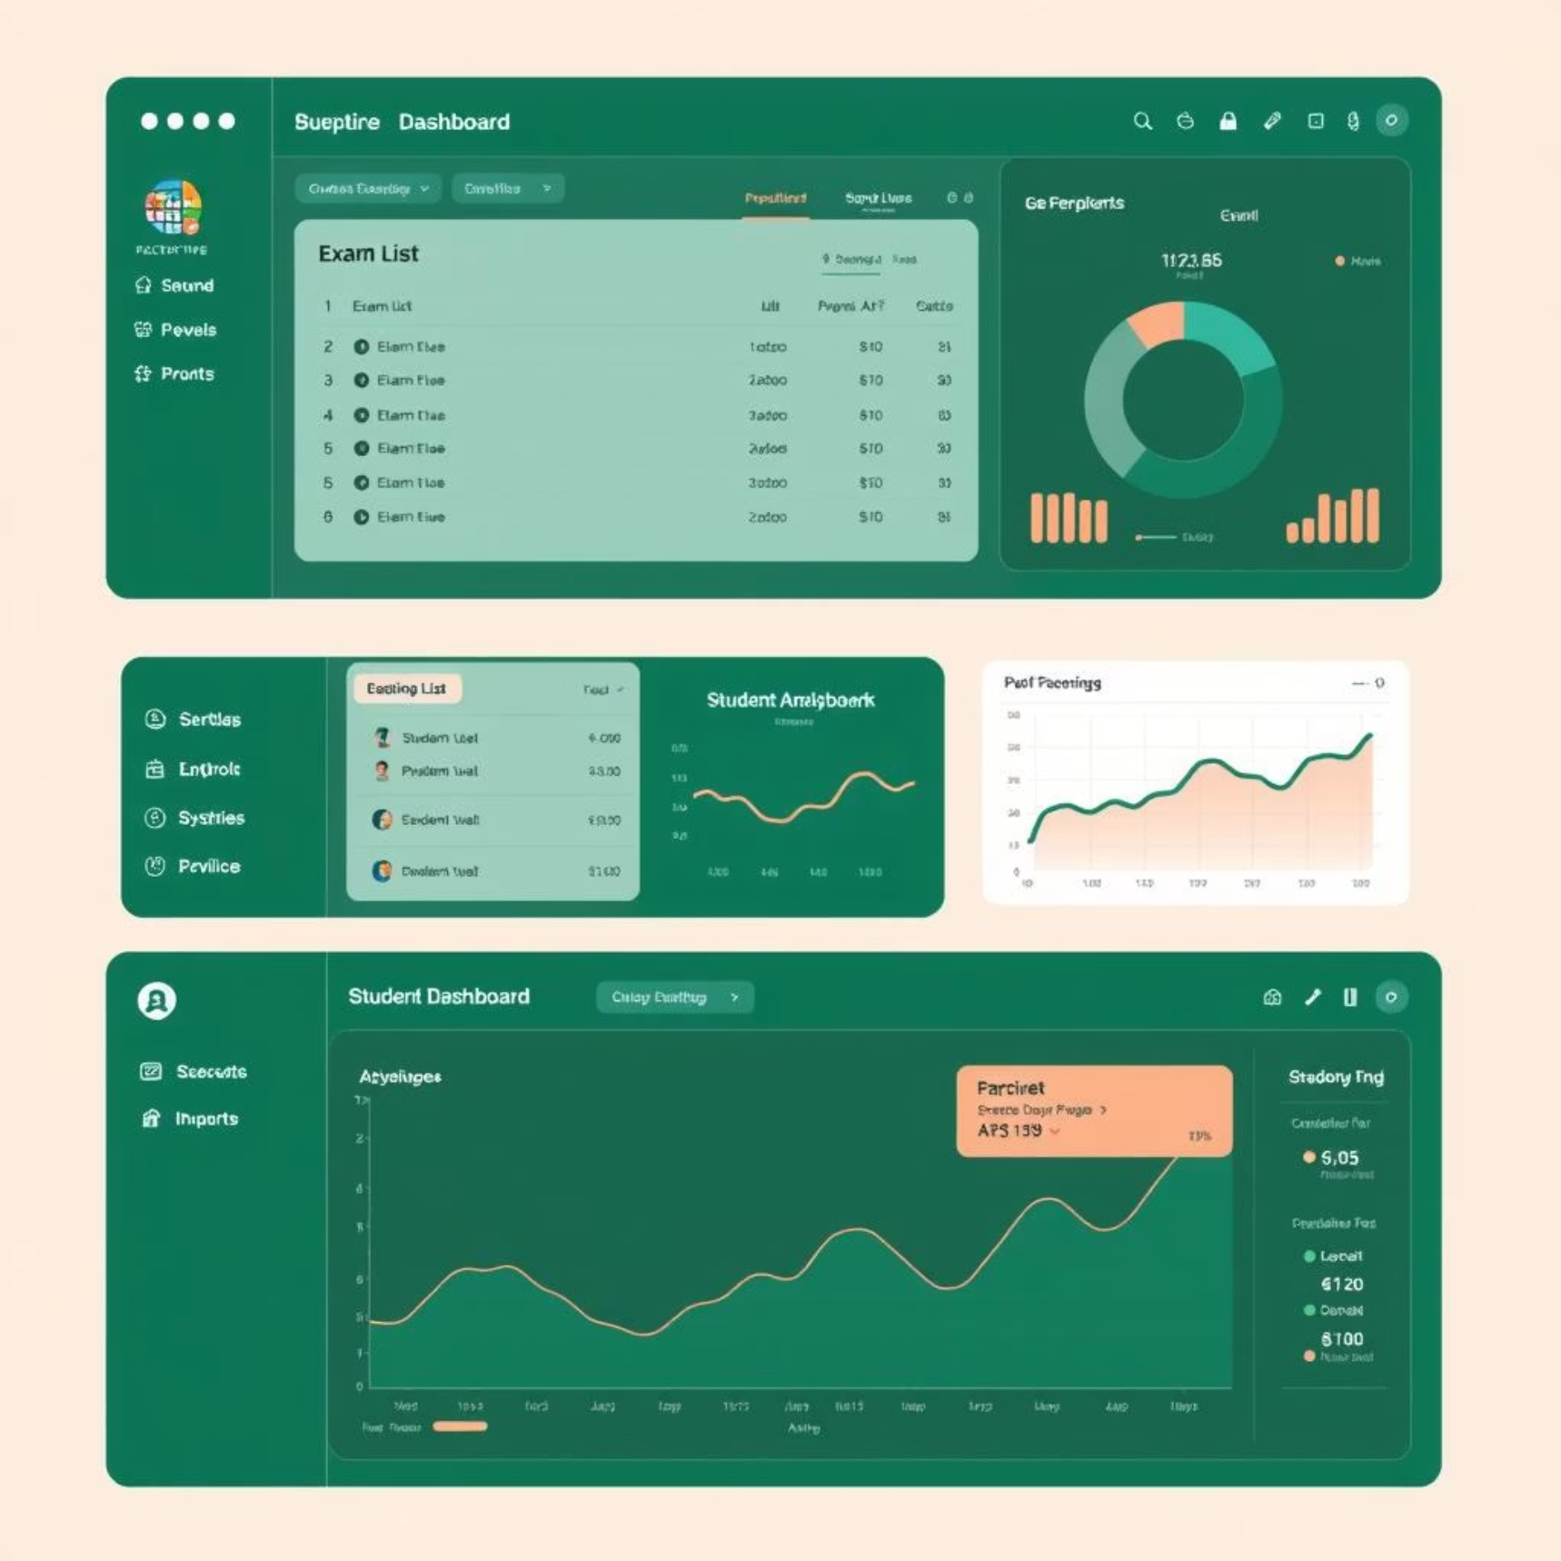
Implementation Details
Student Module
Secure login.
Attempt quizzes & exams.
Timer-based submission.
View individual results.
Teacher Module
Create exams & quizzes.
View student performance.
Access exam-wise results.
Auto-Evaluation
MCQ-based auto checking for quizzes.
Keyword-based subjective marking for exams.

Slide 8
Results & Outcomes
Instant Results
Reduced Workload
Secure Data
Accurate and immediate generation.
Less manual effort for teachers.
Protected student information.
Fair Evaluation
Scalable System
Through automation.
Efficiently handles multiple students and exams.

Slide 9

Conclusion: ExamZone's Impact
ExamZone provides a reliable, secure, and automated examination platform suitable for modern education systems.

Slide 10




Future Enhancements
AI Evaluation
Advanced Analytics
Webcam Proctoring
Mobile Support
AI-based answer evaluation.
Comprehensive dashboards.
For enhanced security.
Application for on-the-go access.

